Slide 1
R Lab Project
Alessandro Valerani 758717

Slide 2
Data Summary

Slide 3
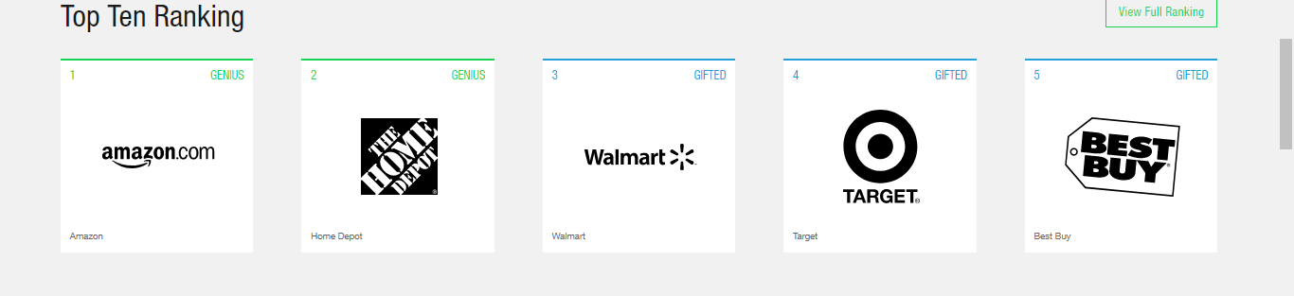
Amazon vs Walmart (Retail)
Walmart and Amazon are competing strongly in the search based retail space.
At the end of 2016, Walmart acquired Jet.com for over $3B as a way to bolster its online sales presence.
https://www.youtube.com/watch?v=6rPEhFTFE9c
At the time the acquisition was considered a short term fix to a long term proble, a band-aid over a gaping wound as Jet.com was spending over $25MLN a month on its advertising without turning any profit. In order to be profitable Jet.com would have needed to $20BLN in sales.

Slide 4
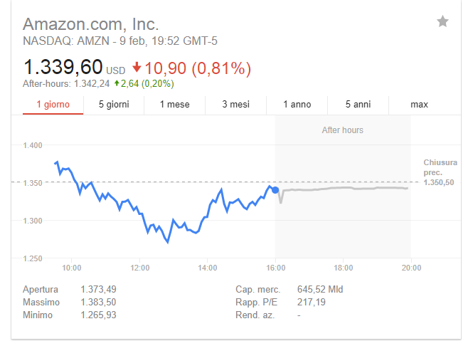
Amazon
Revenue: $136 BLN (2016)
P/E Ratio: 217.19
$26.4B online sales

Slide 5
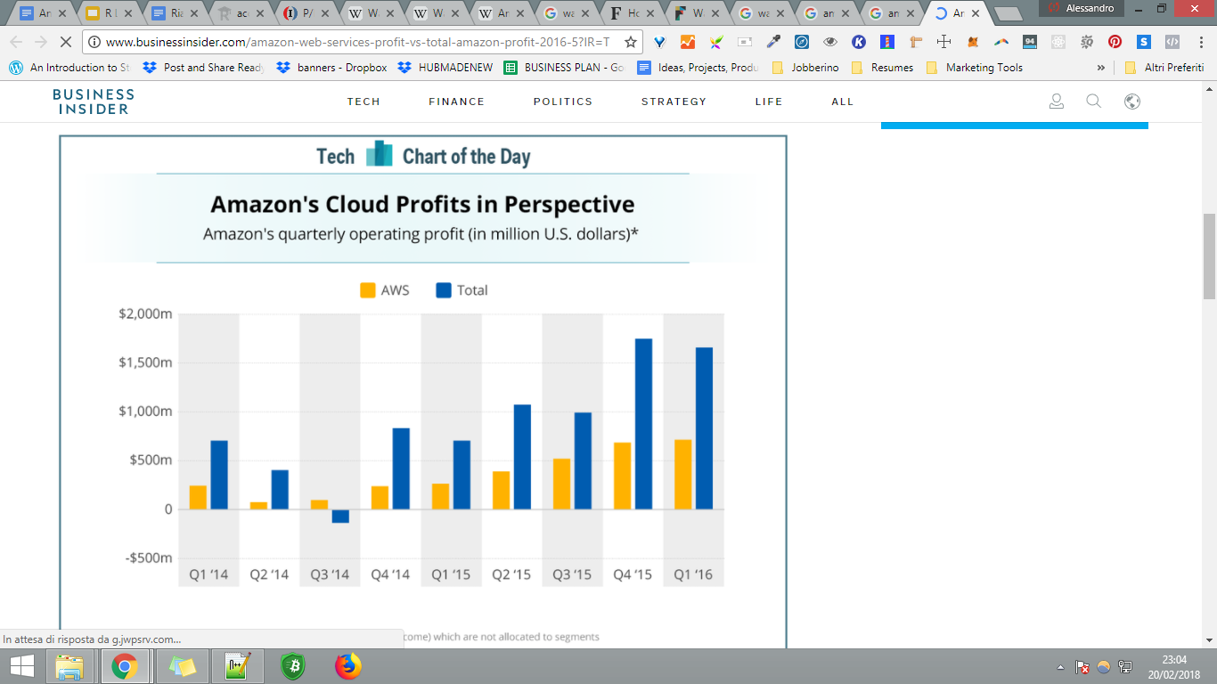
[Business Insider]

Slide 6
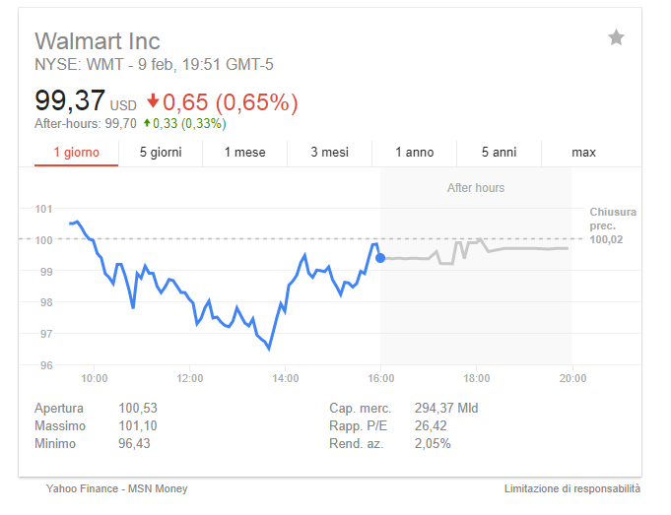
Walmart
Revenue: $485.87 BLN (2016)
P/E Ratio: 26.42
E-commerce currently accounts for only around 3% of Wal-Mart‘s [Forbes]

Slide 7
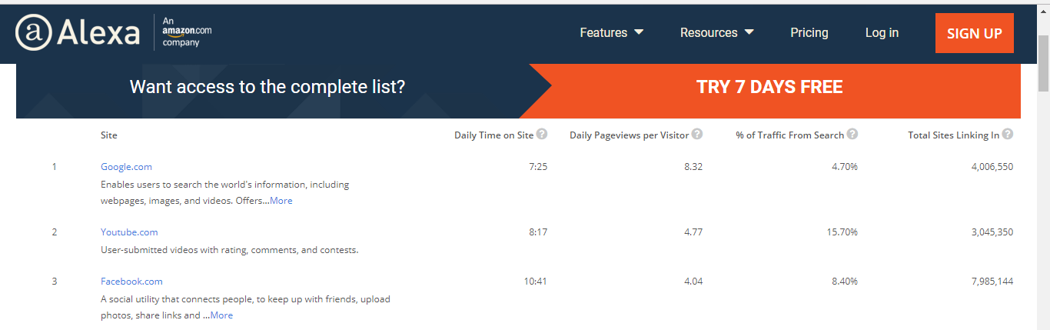
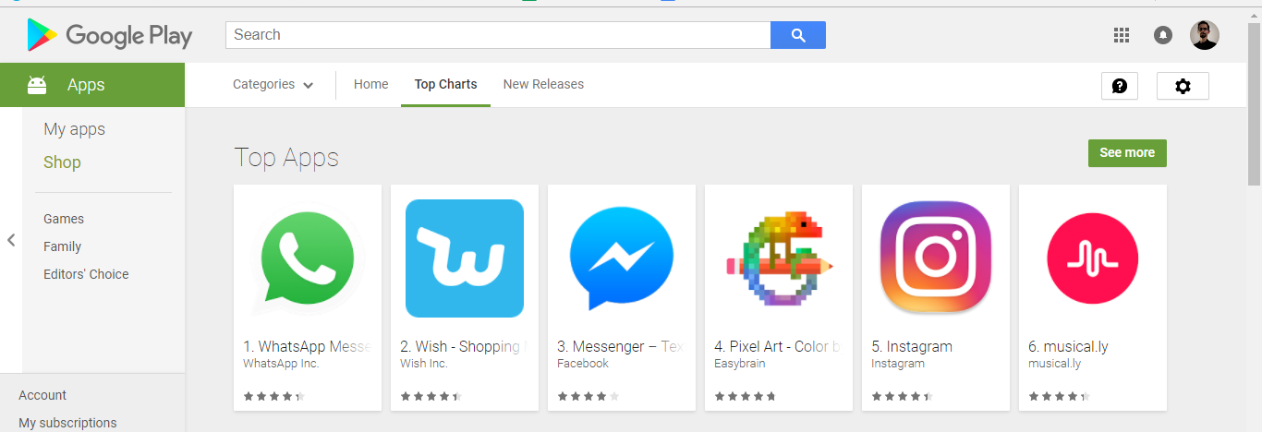
Facebook Vs Google
Most used sites and apps of the world

Slide 8
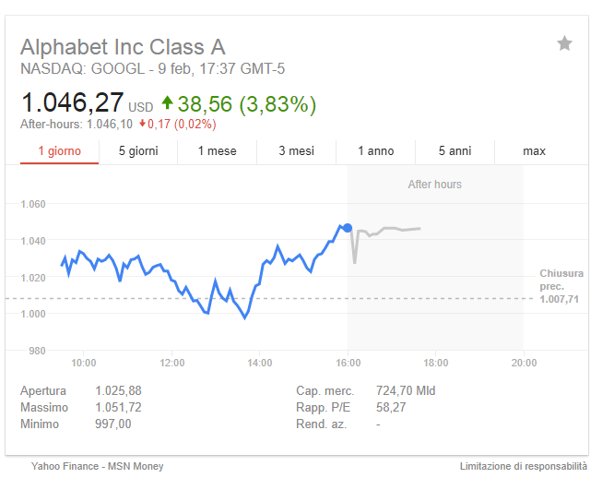
Alphabet (Google)
Revenue: $110.85 BLN (2017)
P/E Ratio: 58.27
Youtube 1.5 Monthly logged in users:
https://techcrunch.com/2017/06/22/youtube-has-1-5-billion-logged-in-monthly-users-watching-a-ton-of-mobile-video/

Slide 9
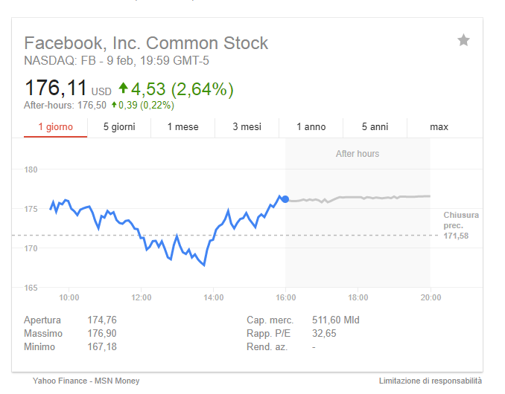
Facebook
Revenue: $40.653 BLN (2017)
P/E Ratio: 32.65
Facebook reach 2BLN monthly active users in June 2017
http://money.cnn.com/2017/06/27/technology/facebook-2-billion-users/index.html

Slide 10
Facebook and Google
60% of advertising revenue in US is made by Google and Facebook
http://fortune.com/2017/07/28/google-facebook-digital-advertising/
The digital advertising sector in 2016 saw Google and Facebook gaining a 103% growth which means that beside them the sector is actually declining.

Slide 11
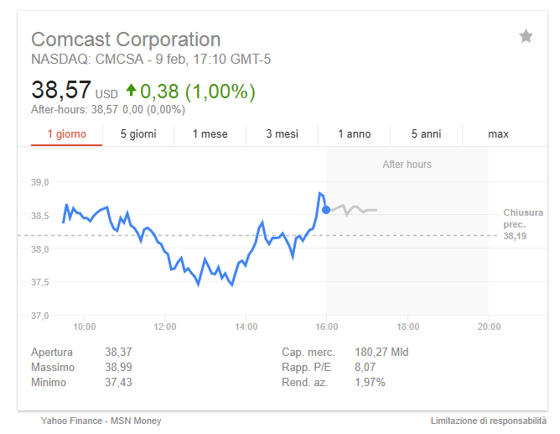
Comcast
Revenue: $84 BLN (2017)
P/E Ratio: 8.07
Facebook reach 2BLN monthly active users in June 2017
http://money.cnn.com/2017/06/27/technology/facebook-2-billion-users/index.html

Slide 12
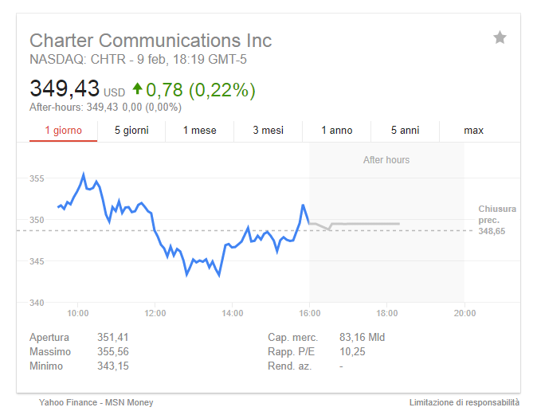
Charter
Revenue: $29 BLN (2016)
P/E Ratio: 10.25
Facebook reach 2BLN monthly active users in June 2017
http://money.cnn.com/2017/06/27/technology/facebook-2-billion-users/index.html

Slide 13
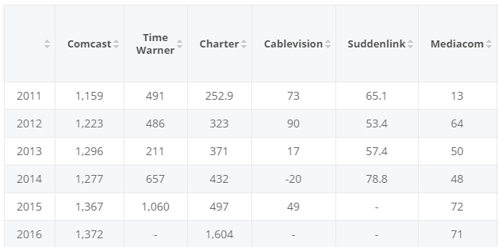
Comcast and Charter combined own 70% market share for 25Mbs
Net number of broadband subscriber additions in the United States[Statista]

Slide 14

Net neutrality has been repealed

Slide 15
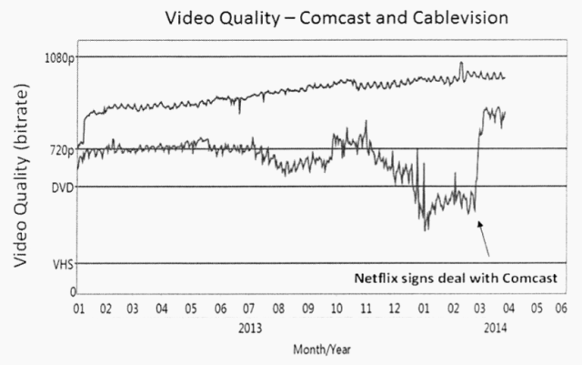
An history of bribing

Slide 16
R Project

Slide 17
Get Data
##DATA SUMMARY
#Si connette a yahoo, e restituisce il valore della stock (passato tramite name)
library(tseries)
get <- function(name){
x <- get.hist.quote(instrument = name, start = "2008-01-01", end="2017-10-01",
quote = c("Adjusted"), compression="m")
}
##c("Open", "High", "Low", "Close", "Adjusted", "Volume")
Returns a ‘zoo’ (Adjusted Monthly Prices) for the inputted ticker

Slide 18
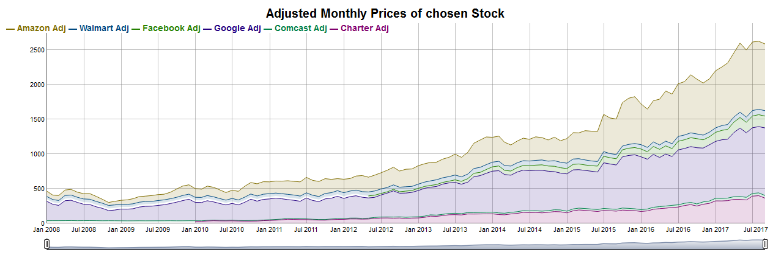
Dygraph (Visualization)

Slide 19
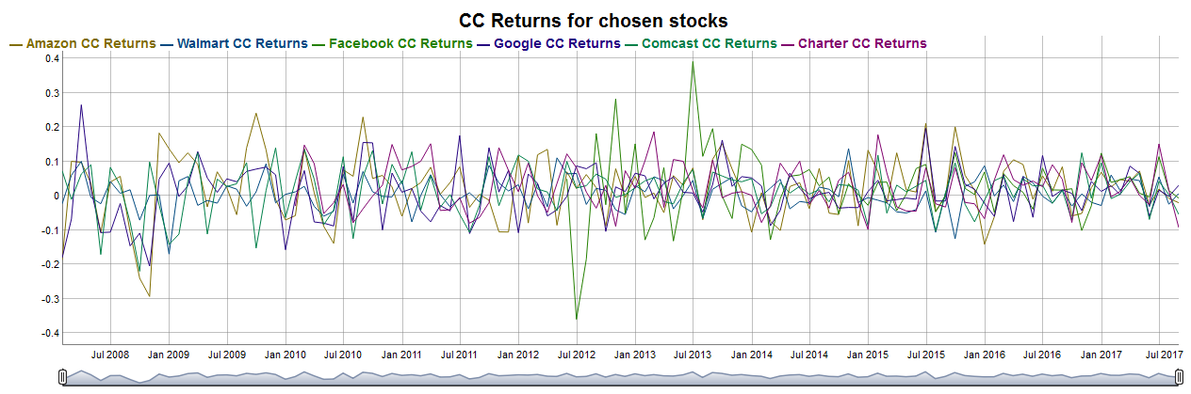
Returns

Slide 20
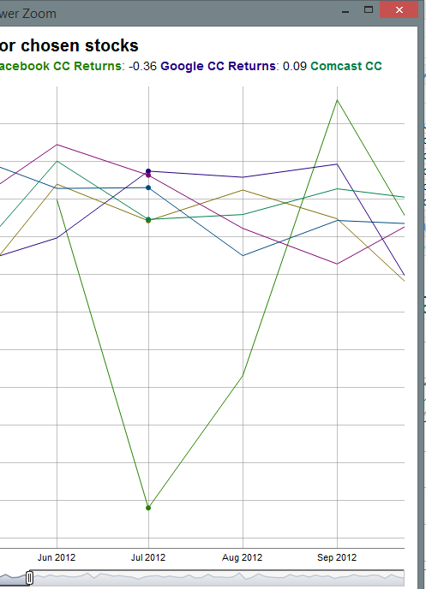
Facebook stock dips after IPO

Slide 21
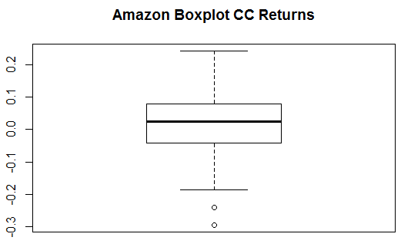
Boxplots
#CC Returns
Amazon.adj.retCC = diff(log(Amazon.adj.z))
boxplot(coredata(Amazon.adj.retCC), main="Amazon Boxplot CC Returns")

Slide 22
4 Plots
#Amazon
Amazon.ret.mat = coredata(Amazon.adj.retCC) ##Solo i valori dei CC returns
Amazon.density = density(coredata(Amazon.adj.retCC)) ##Densità
par(mfrow=c(2,2)) ##Mostrerà 4 plot (2 righe, 2 colonne)
##Grafico dei monthly returns
plot(Amazon.adj.retCC, main="Monthly cc returns on Amazon", xlab="", ylab="cc returns",lwd=2, col="blue")
abline(h=0) ##Linea dritta ad altezza 0
#Istogramma distribuzione rispetto a normale
hist(Amazon.ret.mat, main="Monthly cc returns on Amazon", xlab="Amazon.adj.retCC", col="red", probability=TRUE, ylim=c(0,8))
points(Amazon.density,type="l", col="blue", lwd=2)
#Boxplot
boxplot(Amazon.ret.mat, main="Amazon Boxplot CC Returns")
##Disegna i quantili teorici vs quelli veri + linea dei quantili
qqnorm(Amazon.ret.mat, main="Amazon Returns", col="blue")
qqline(Amazon.ret.mat)
par(mfrow=c(1,1))

Slide 23
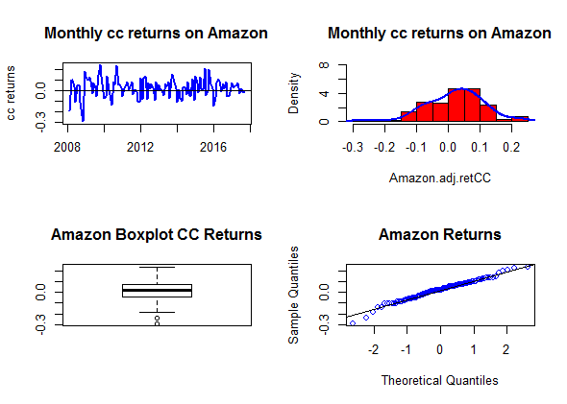

Slide 24
Univariate Analysis
#Amazon
> mean(Amazon.ret.mat) # 0.0216852
> var(Amazon.ret.mat) # 0.008253085
> sd(Amazon.ret.mat) # 0.09084649
> skewness(Amazon.ret.mat) # -0.4007064
> kurtosis(Amazon.ret.mat) # 0.8515085
> summary(Amazon.ret.mat)
Adjusted
Min. :-0.29305
1st Qu.:-0.03882
Median : 0.02532
Mean : 0.02169
3rd Qu.: 0.07928
Max. : 0.24106

Slide 25
Sample Covariance Matrix
Amazon.coda = coredata(tail(Amazon.ret.mat, minimo))
var(cbind(Amazon.coda,
Walmart.coda,
Facebook.coda,
Google.coda,
Comcast.coda,
Charter.coda))

Slide 26
Sample Covariance Matrix
 | AmazonRetCC | WalmartRetCC | FacebookRetCC | GoogleRetCC | ComcastRetCC | CharterRetCC
AmazonRetCC | 5.13E-03 | 7.72E-05 | 0.0013655532 | 2.39E-03 | 0.0010604552 | 0.0010581641
WalmartRetCC | 7.72E-05 | 1.99E-03 | -0.0003069339 | -4.86E-05 | 0.0004695905 | 0.0004546492
FacebookRetCC | 1.37E-03 | -3.07E-04 | 0.0111834134 | 8.39E-04 | 0.0007733719 | -0.000989344
GoogleRetCC | 2.39E-03 | -4.86E-05 | 0.0008387805 | 3.17E-03 | 0.0007224683 | 0.0004477737
ComcastRetCC | 1.06E-03 | 4.70E-04 | 0.0007733719 | 7.22E-04 | 0.0023924539 | 0.0019691165
CharterRetCC | 1.06E-03 | 4.55E-04 | -0.000989344 | 4.48E-04 | 0.0019691165 | 0.0044323028

Slide 27
Sample Correlation Matrix
##Correlation Matrix
cor(cbind(Amazon.coda,
Walmart.coda,
Facebook.coda,
Google.coda,
Comcast.coda,
Charter.coda))

Slide 28
Sample Correlation Matrix
 | AmazonRetCC | WalmartRetCC | FacebookRetCC | GoogleRetCC | ComcastRetCC | CharterRetCC
AmazonRetCC | 1 | 0.02412033 | 0.18022008 | 0.59385585 | 0.3025884 | 0.2218299
WalmartRetCC | 0.02412033 | 1 | -0.06500293 | -0.01935963 | 0.215017 | 0.1529456
FacebookRetCC | 0.18022008 | -0.06500293 | 1 | 0.14096049 | 0.1495132 | -0.1405224
GoogleRetCC | 0.59385585 | -0.01935963 | 0.14096049 | 1 | 0.2625024 | 0.1195309
ComcastRetCC | 0.30258842 | 0.21501704 | 0.14951316 | 0.26250239 | 1 | 0.6046929
CharterRetCC | 0.2218299 | 0.15294561 | -0.14052236 | 0.11953088 | 0.6046929 | 1

Slide 29
Sample Correlation Matrix
Comcast and Charter share a high 0.6, suggesting that these stocks are being treated similarly on the market
Amazon is sharing a moderate correlation with all but Walmart which is its most direct competitor

Slide 30
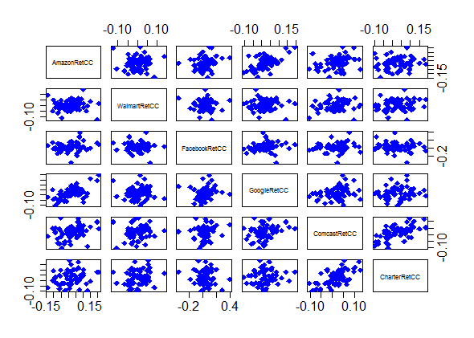
All Pairs
#PAIRWISE SCATTERPLOT
pairs(cbind(Amazon.coda,
Walmart.coda,
Facebook.coda,
Google.coda,
Comcast.coda,
Charter.coda), col="blue", pch=18, cex=1.5, cex.axis=1.5)

Slide 31
Predictive Analysis (ARMA)
library( forecast )
returnsTrain <- returns[1:(n * length(returns))] # Train dataset
returnsTest <- returns[(n * length(returns) + 1):(n * length(returns)+ 1 + m * length(returns))] # Test dataset
fit <- arima(returnsTrain, order = c(2, 0, 2))
arma.preds <- predict(fit, n.ahead = (length(returns) - (n * length(returns))))$pred
arma.forecast <- forecast(fit, h = 35)
plot(arma.forecast, main = "ARMA forecasts for Amazon returns")
accuracy(arma.preds, returnsTest)[2] # RMSE values
lines( returnsTest )

Slide 32
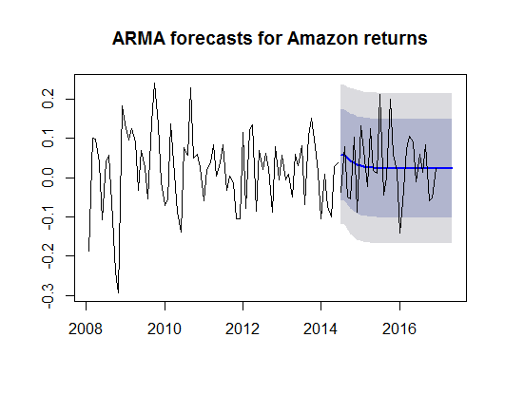
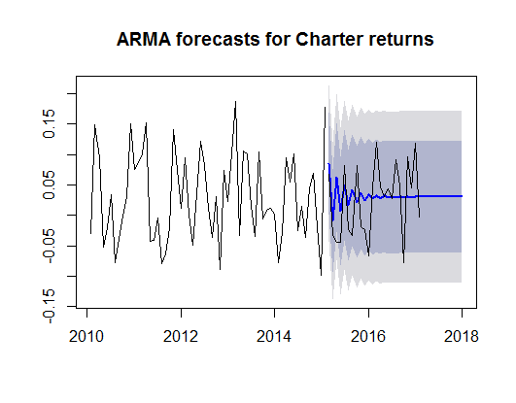
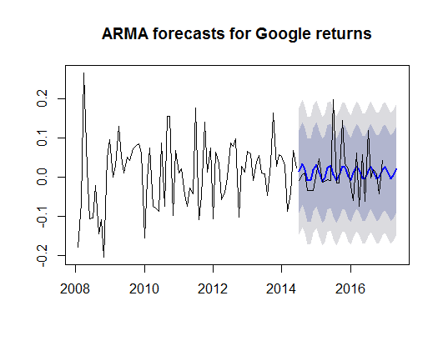
Predictive Analysis (ARMA)

Slide 33
Predictive Analysis (ARMA)
print("Accuracy - Comcast")
print(accuracy(arma.preds, returnsTest)[2]) # RMSE values
Amazon Accuracy
0.08411751
Walmart Accuracy
0.04998011
Facebook Accuracy
0.05643034
Google Accuracy
0.05670273
Comcast Accuracy
0.05922246
Charter Accuracy
0.057656
L'errore quadratico medio è uguale alla somma della varianza e del quadrato del bias di uno stimatore

Slide 34
Beta Computation
All stocks belong to the S&P500 which I will reference
##Fatto con performance analytics
> CAPM.beta(Amazon.adj.ret, SP500.adj.ret, Rf = 0)
[1] 0.984947
> CAPM.beta(Walmart.adj.ret, SP500.adj.ret, Rf = 0)
[1] 0.3322981
> CAPM.beta(Facebook.adj.ret, SP500.adj.ret, Rf = 0)
[1] 0.6923669
> CAPM.beta(Google.adj.ret, SP500.adj.ret, Rf = 0)
[1] 1.01724
> CAPM.beta(Comcast.adj.ret, SP500.adj.ret, Rf = 0)
[1] 1.07621
> CAPM.beta(Charter.adj.ret, SP500.adj.ret, Rf = 0)
[1] 0.8444471

Slide 35


Beta Computation

Slide 36
Portoflio Management via Mean-Variance
library(fPortfolio)
library(lpSolve)
library(timeSeries)
##Deve essere timerSeries
Amazon.timeS = as.timeSeries(Amazon.adj.ret)
I’ve used: pf <- portfolioFrontier(Data) to calculate the efficient frontier, minimizing risk and using an alpha of 0.05

Slide 37
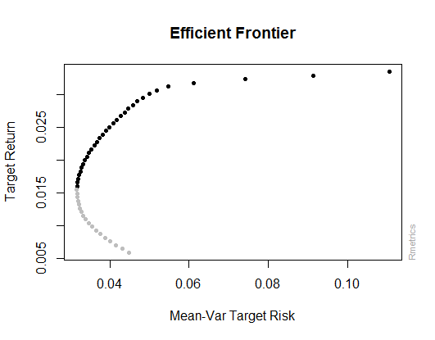
Portoflio Management via Mean-Variance

Slide 38
Portoflio Management via Mean-Variance
Portfolio Weights:
Amazon.Adj Walmart.Adj Facebook.Adj Google.Adj Comcast.Adj Charter.Adj
1 0.0000 1.0000 0.0000 0.0000 0.0000 0.0000
13 0.0000 0.5444 0.0346 0.2185 0.2024 0.0000
25 0.0216 0.3316 0.1184 0.2423 0.0617 0.2245
37 0.0700 0.0890 0.1933 0.2320 0.0000 0.4156 Chosen Weights
50 0.0000 0.0000 1.0000 0.0000 0.0000 0.0000
Target Returns and Risks:
mean Cov CVaR VaR
1 0.0059 0.0449 0.0913 0.0526
13 0.0127 0.0324 0.0565 0.0273
25 0.0194 0.0333 0.0413 0.0308
37 0.0261 0.0417 0.0410 0.0317
50 0.0335 0.1106 0.1929 0.1204

Slide 39
Portoflio Management via Mean-Variance
budget <- 1000
## suppose to have a budget of $V at the begin of the l months (with the same value of l previously defined in the forecasting) and decide how to invest your budget to create your portoflio.
peso_amazon <- 0.0216
peso_walmart <- 0.3316
peso_facebook <- 0.1184
peso_google <- 0.2423
peso_comcast <- 0.0617
peso_charter <- 0.2245
transaction_cost <- 15 #1.5% transaction cost

Slide 40
Portoflio Management via Mean-Variance
transazioni <- 6 #Compro le stock una volta
## compute your return (you must consider transaction costs) at the end of the period according to your investment decisions
ritorni_netti <- sum((sum(tail(Amazon.adj.ret, minimo * l)) * peso_amazon * budget),
(sum(tail(Walmart.adj.ret, minimo * l)) * peso_walmart * budget),
(sum(tail(Facebook.adj.ret, minimo * l)) * peso_facebook * budget),
(sum(tail(Google.adj.ret, minimo * l)) * peso_google * budget),
(sum(tail(Comcast.adj.ret, minimo * l)) * peso_comcast * budget),
(sum(tail(Charter.adj.ret, minimo * l)) * peso_charter * budget),
-transaction_cost * transazioni)
##> ritorni_netti
##[1] 35.27504 = 3.527504%
Which netted a 3.527504% return.

Slide 41
Conclusions
Facebook, Google and Amazon are very interesting stocks, with huge growth and interesting swings, as now leading the growth of the S&P500.
Walmart is the least volatile stock, might be useful to reduce risk.
Comcast and Charter seem to be moving at unison (high correlation)

